Slide 1

EMBEDDINGS

Slide 2

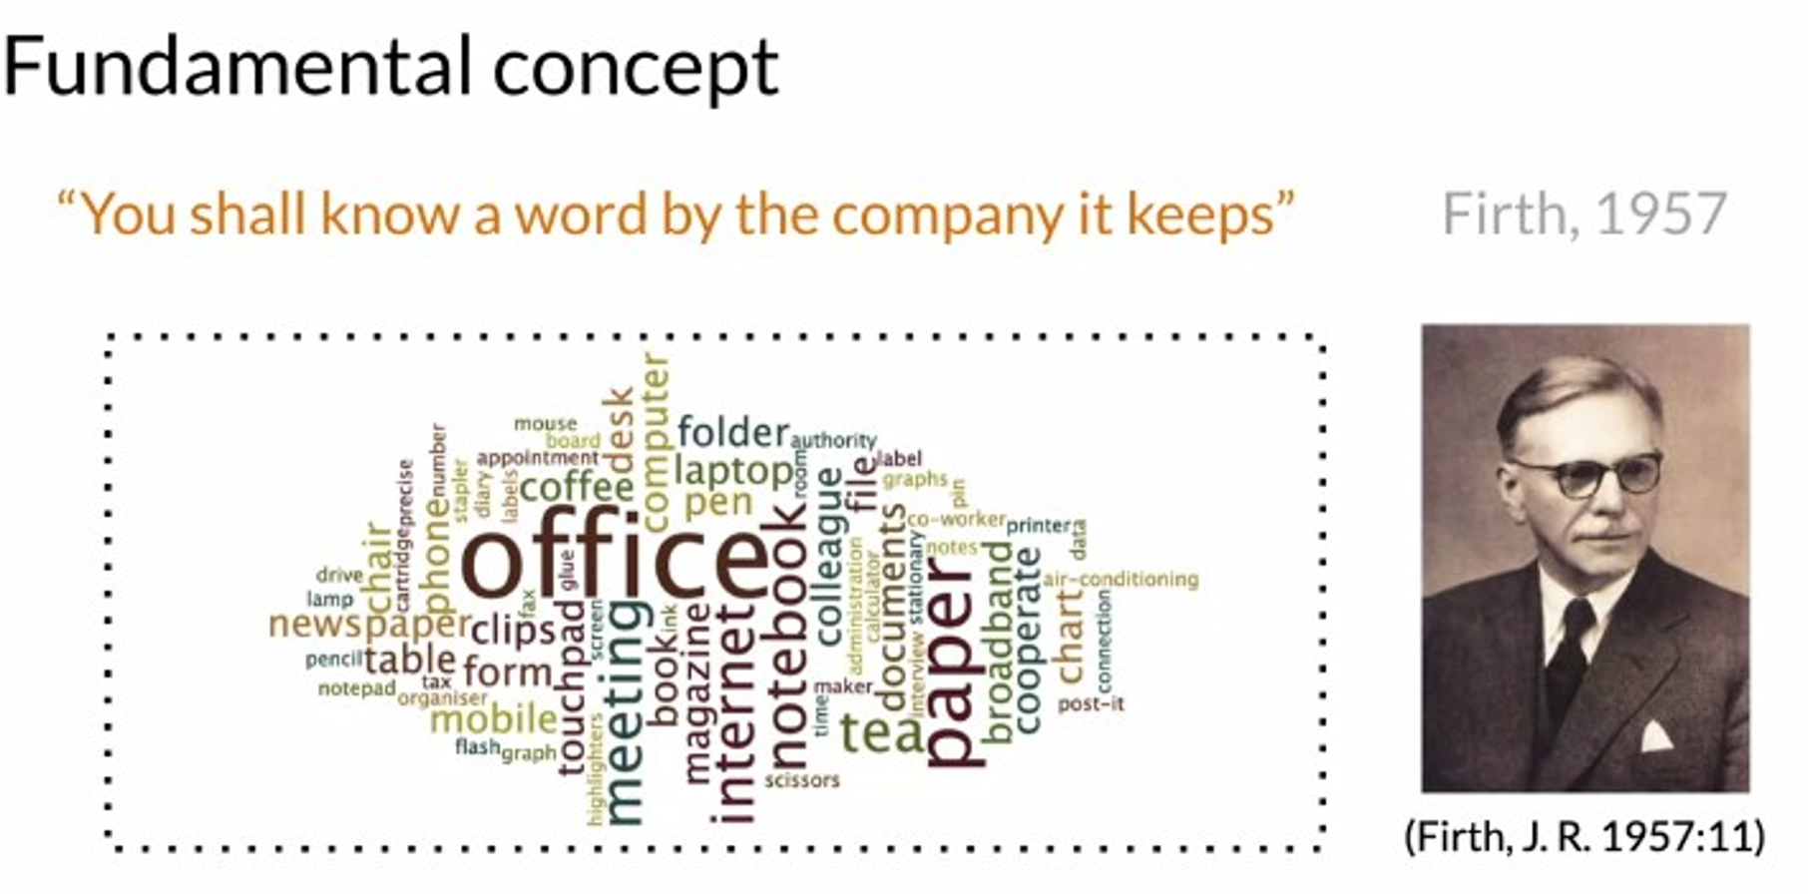
conceptFundamental
"You shall know a word by the company it keeps"

Slide 3
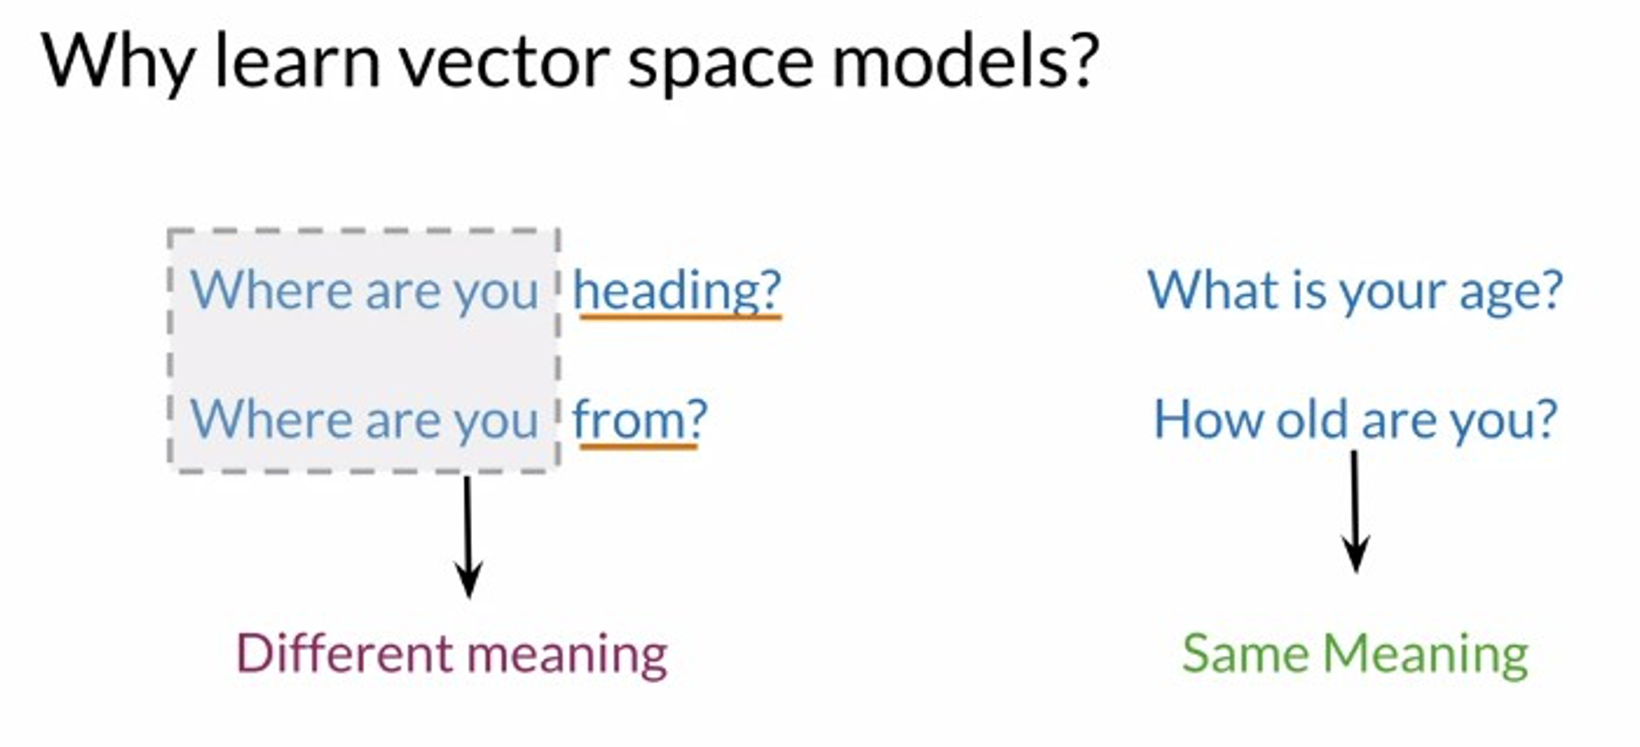

Why learn vector space models?

Slide 4



WHAT ARE EMBEDDINGS?
Embeddings are mathematical representations of unstructured information (text, sound, images) that allows objects with similar semantics to have similar representations
e.g. in a good text embedding, words with similar meanings are embedded in similar vectors (contrast this with BoW)
e.g. in a good image embedding, pictures with similar objects are embedded in similar vectors
Data Squad | Supervised Learning

Slide 5
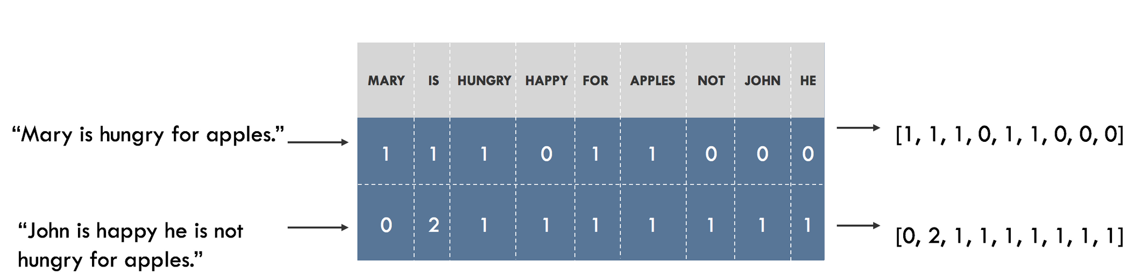

Embeddings
from words to numbers

Slide 6


Embeddings
from words to numbers
What if we could represent the words via its “meaning” and not its letters?
Using only “letters”
User query: “Someone in my class had a question!
Student
Lab
Exercise

Slide 7

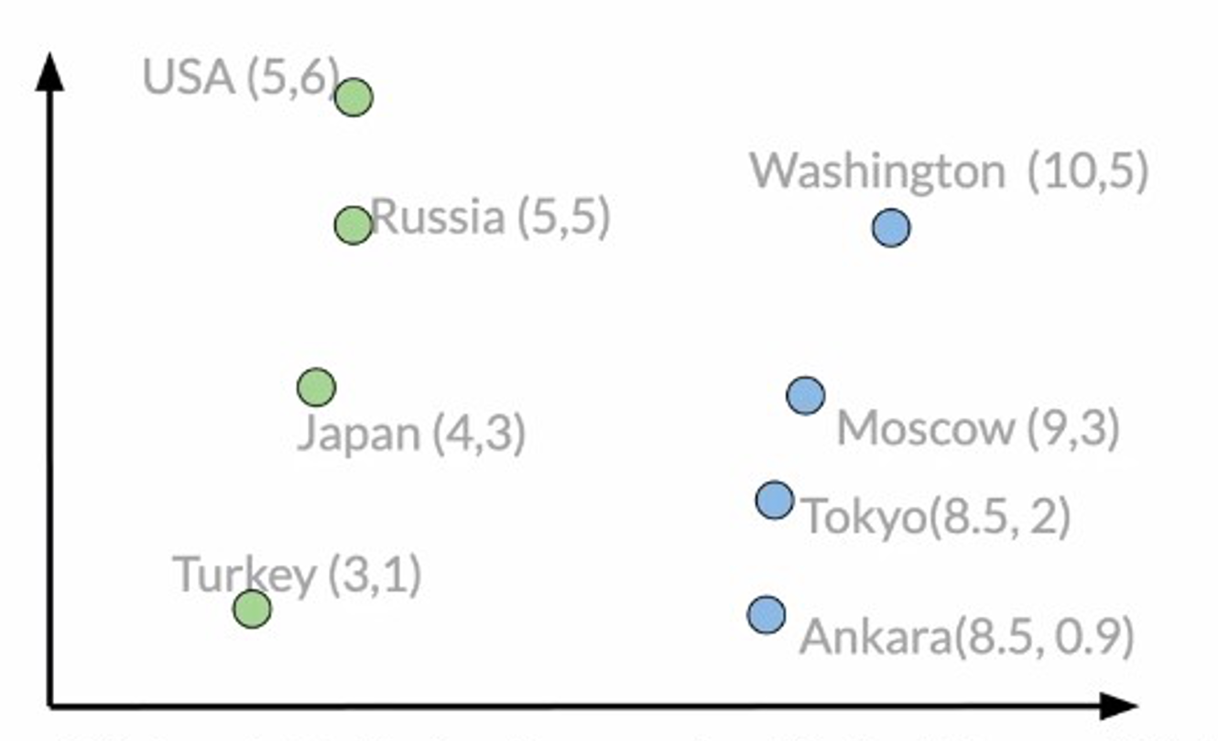
Embeddings
from words to numbers

Slide 8
Embeddings
from words to numbers
The classroom dashboard integrates data from Students and Teachers to display attendance and grades. Teachers use the platform to assign Exercises and Lessons to Students. Labs provide practical exercises that complement the theoretical Lessons. Slides are used by Teachers during Lessons to illustrate key points. Assignments are tracked and graded by Teachers, with results available to Students. Quizzes are periodically given to assess Students' understanding of the material. The curriculum outlines the sequence of Lessons and Labs for the term. Attendance is monitored daily and logged by Teachers. Grades are calculated based on performance in Assignments, Quizzes, and Labs. Students can view their progress in real-time on their dashboard. Teachers use data from Lessons and Quizzes to tailor future Exercises and Assignments.
"Where can I find the slides for today's lesson?" "How do I submit my assignment?" "What exercises should I complete for the lab session?" "Can I review my grades for the last quiz?" "How is attendance being tracked in our classroom?" "Is there a way to see the curriculum for this semester?" "Can the teacher upload the slides from yesterday's lesson?" "How do I know which labs I need to complete?" "What is the due date for the current assignment?" "How are grades calculated from quizzes and assignments?" "Can the teacher see which students have completed the exercises?"
Student
Lessons
Teachers
Assignments
Exercises
Slides
Labs
Grades
Curriculum
Attendance
Quizzes

Slide 9
Embeddings
from words to numbers
The classroom dashboard integrates data from Students and Teachers to display attendance and grades. Teachers use the platform to assign Exercises and Lessons to Students. Labs provide practical exercises that complement the theoretical Lessons. Slides are used by Teachers during Lessons to illustrate key points. Assignments are tracked and graded by Teachers, with results available to Students. Quizzes are periodically given to assess Students' understanding of the material. The curriculum outlines the sequence of Lessons and Labs for the term. Attendance is monitored daily and logged by Teachers. Grades are calculated based on performance in Assignments, Quizzes, and Labs. Students can view their progress in real-time on their dashboard. Teachers use data from Lessons and Quizzes to tailor future Exercises and Assignments.
"Where can I find the slides for today's lesson?" "How do I submit my assignment?" "What exercises should I complete for the lab session?" "Can I review my grades for the last quiz?" "How is attendance being tracked in our classroom?" "Is there a way to see the curriculum for this semester?" "Can the teacher upload the slides from yesterday's lesson?" "How do I know which labs I need to complete?" "What is the due date for the current assignment?" "How are grades calculated from quizzes and assignments?" "Can the teacher see which students have completed the exercises?"
Assignments
Student
Curriculum
Grades
Lessons
Teachers
Labs
Exercises
Slides
Attendance
Quizzes

Slide 10
Embeddings
from words to numbers
The classroom dashboard integrates data from Students and Teachers to display attendance and grades. Teachers use the platform to assign Exercises and Lessons to Students. Labs provide practical exercises that complement the theoretical Lessons. Slides are used by Teachers during Lessons to illustrate key points. Assignments are tracked and graded by Teachers, with results available to Students. Quizzes are periodically given to assess Students' understanding of the material. The curriculum outlines the sequence of Lessons and Labs for the term. Attendance is monitored daily and logged by Teachers. Grades are calculated based on performance in Assignments, Quizzes, and Labs. Students can view their progress in real-time on their dashboard. Teachers use data from Lessons and Quizzes to tailor future Exercises and Assignments.
"Where can I find the slides for today's lesson?" "How do I submit my assignment?" "What exercises should I complete for the lab session?" "Can I review my grades for the last quiz?" "How is attendance being tracked in our classroom?" "Is there a way to see the curriculum for this semester?" "Can the teacher upload the slides from yesterday's lesson?" "How do I know which labs I need to complete?" "What is the due date for the current assignment?" "How are grades calculated from quizzes and assignments?" "Can the teacher see which students have completed the exercises?"
Assignments
Student
Curriculum
Grades
Lessons
Teachers
Labs
Exercises
Slides
Attendance
Quizzes

Slide 11
Embeddings
from words to numbers
The classroom dashboard integrates data from Students and Teachers to display attendance and grades. Teachers use the platform to assign Exercises and Lessons to Students. Labs provide practical exercises that complement the theoretical Lessons. Slides are used by Teachers during Lessons to illustrate key points. Assignments are tracked and graded by Teachers, with results available to Students. Quizzes are periodically given to assess Students' understanding of the material. The curriculum outlines the sequence of Lessons and Labs for the term. Attendance is monitored daily and logged by Teachers. Grades are calculated based on performance in Assignments, Quizzes, and Labs. Students can view their progress in real-time on their dashboard. Teachers use data from Lessons and Quizzes to tailor future Exercises and Assignments.
"Where can I find the slides for today's lesson?" "How do I submit my assignment?" "What exercises should I complete for the lab session?" "Can I review my grades for the last quiz?" "How is attendance being tracked in our classroom?" "Is there a way to see the curriculum for this semester?" "Can the teacher upload the slides from yesterday's lesson?" "How do I know which labs I need to complete?" "What is the due date for the current assignment?" "How are grades calculated from quizzes and assignments?" "Can the teacher see which students have completed the exercises?"
Assignments
Student
Curriculum
Grades
Lessons
Teachers
Are the assignments mandatory?
Labs
Exercises
Slides
Attendance
Quizzes

Slide 12

Embeddings
from words to numbers
Assignments
Student
Grades
Are the assignments mandatory?
Curriculum
Lessons
Teachers
Are the assignments mandatory?
Docname; source
Docname;source
Docname;source
Docname;source
Docname;source
Docname;source
Labs
Exercises
Slides
Attendance
Quizzes

Slide 13
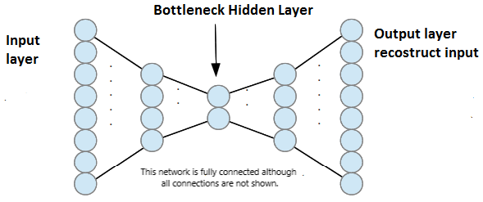
AUTOENCODERS
Unsupervised dimensionality reduction technique
Forces bottleneck layer to encode all information
Good shortcut to encode information is via semantics (meaning)

Slide 14
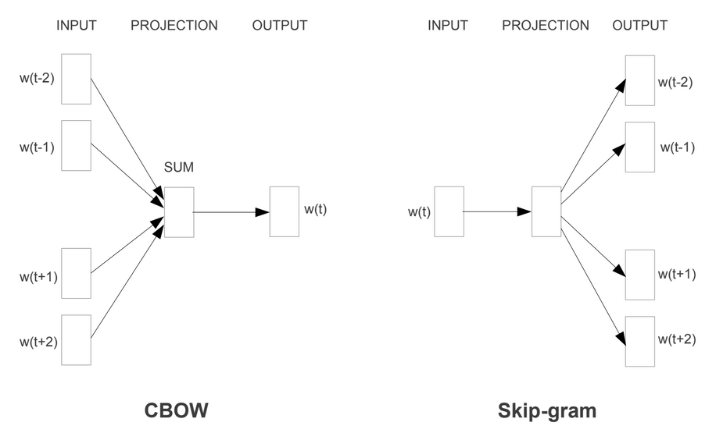
WORD EMBEDDINGS - WORD2VEC
Enriches the notion of autoencoder by considering not only the word but also the words that show up around it
Two versions, depending if it's more important to guess the word based on the context or predict the context based on the word
We have huge corpuses for training, essentially all of literature created so far

Slide 15

WORD EMBEDDINGS - BERT FAMILY
Word2Vec still associates the same vector to the same word
BERT - Bidirectional Encoder Representations from Transformers consider not only the word but also it's context *during encoding*, which means it can extract different meanings from the same word
"the man robbed a bank" vs "the bank of the river was flooded"

Slide 16

EMBEDDINGS
Pro : can be used pre-trained if your application is generic. For the vast majority of cases the word embeddings trained on Wikipedia are good enough
Pro: can be customized from a pre-learned model at a fraction of the cost. If you have a relatively modest corpus, you can piggyback on a pre trained model that already knows most of the smeantics of english
Con: can be quite difficult to train from scratch. Pretty much only google and a few other large data holders can create these models (queue GPT3)
Con: they are too cool. Food and shelter are also needed but pale in comparison.

